Slide 1
Data structures and algorithm

Slide 2

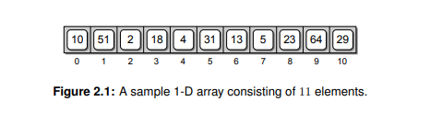
Array Data Structure
Arrays are similar to list. Only difference is
The access. Once an array is created, its size cannot be changed.
List access in sequentially and Arrays are
Can be accessed by random.
The entire contents of an array are identified by a single name.
Individual elements within the array can be accessed directly by
specifying an integer subscript or index value, which indicates an
offset from the start of the array

Slide 3
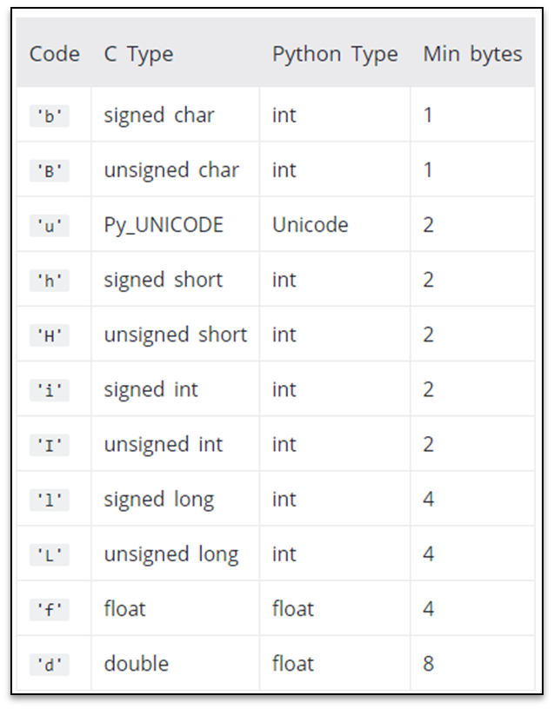

Slide 4
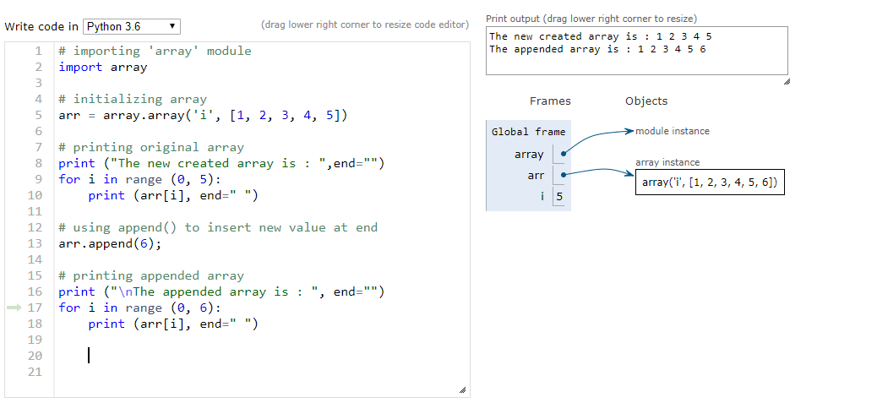

Slide 5
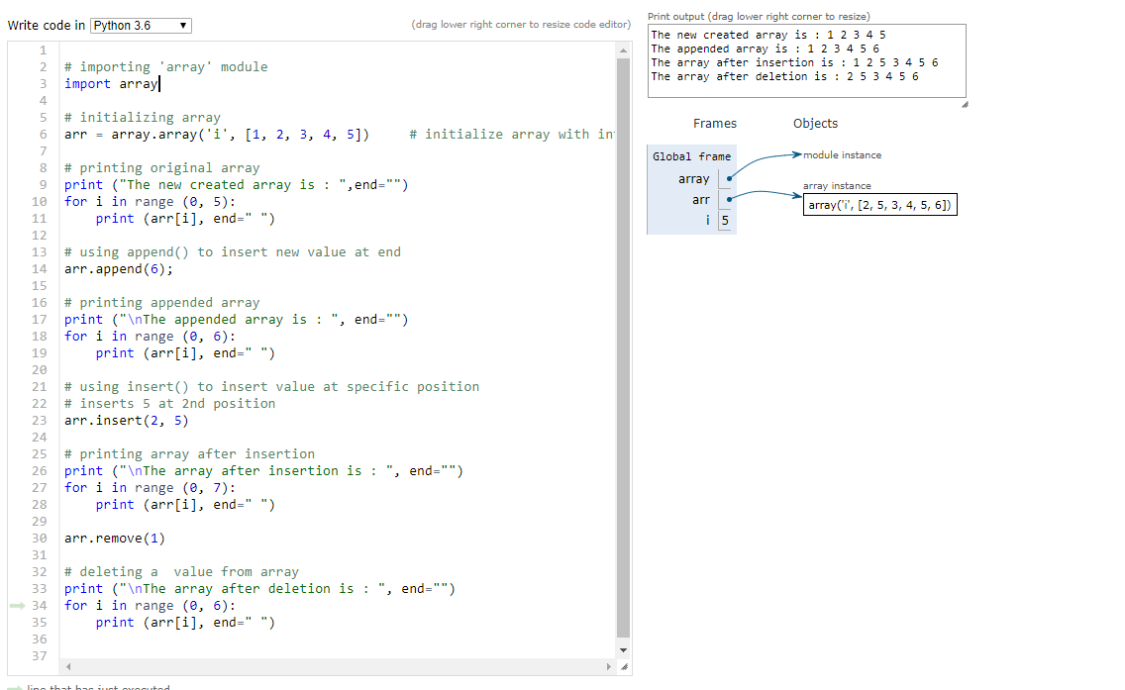

Slide 6

Disadvantages of Array
Fixed size: The size of the array is static (specify the array size before using it, this can be overcome using Dynamic Arrays).
One block allocation: To allocate the array itself at the beginning, sometimes it may not be possible to get the memory for the complete array (if the array size is big).
Complex position-based insertion: To insert an element at a given position, we may need to shift the existing elements. This will create a position for us to insert the new element at the desired position. If the position at which we want to add an element is at the beginning, then the shifting operation is more expensive

Slide 7

Linked list
Like arrays, Linked List is a linear data structure. Unlike arrays, linked list elements are not stored at a contiguous location(sharing border);
the elements are linked using pointers.
Why Linked List?
Arrays can be used to store linear data of similar types, but arrays have the following limitations.
1) The size of the arrays is fixed:
2) Inserting a new element in an array of elements is expensive because the room has to be created for the new elements and to create room existing elements have to be shifted.

Slide 8

Representation
A linked list is represented by a pointer to the first node of the linked list. The first node is called the head. If the linked list is empty, then the value of the head is NULL.
Each node in a list consists of at least two parts:
1) data
2) Pointer (Or Reference) to the next node

Slide 9
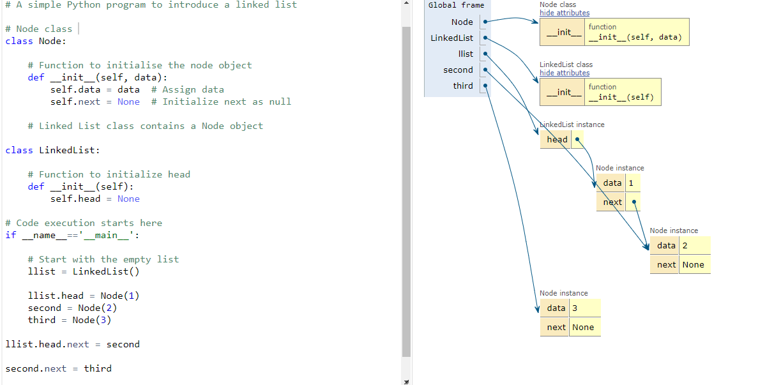

Slide 10
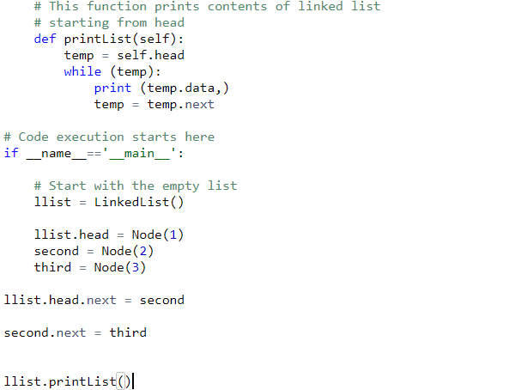
Print the data in linked list

Slide 11
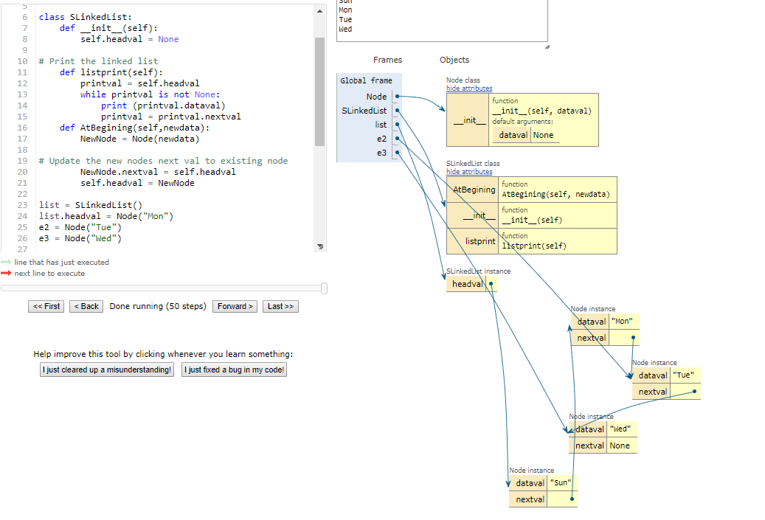
Examples of linked list-Adding Front

Slide 12
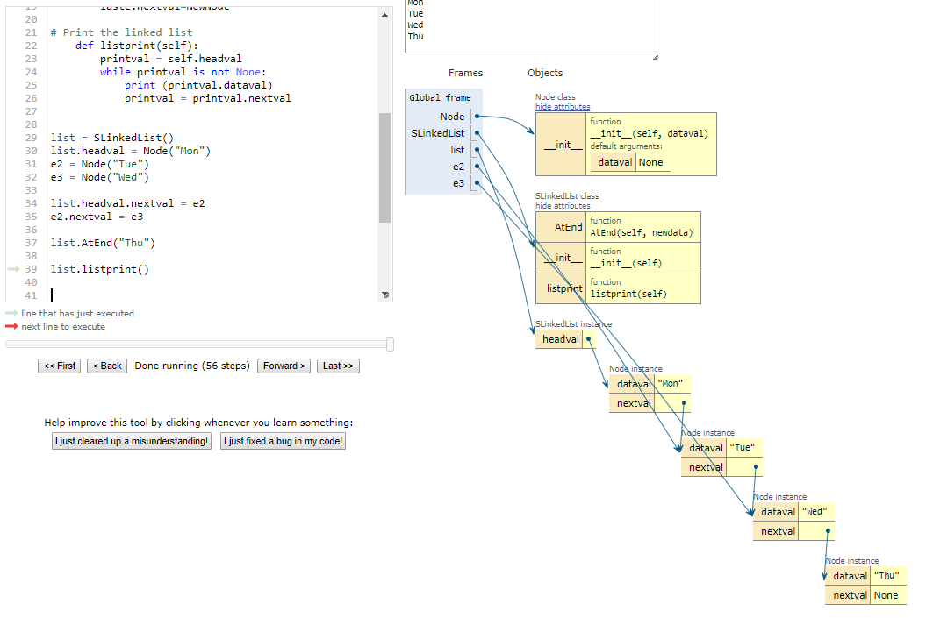
Adding the data at End

Slide 13
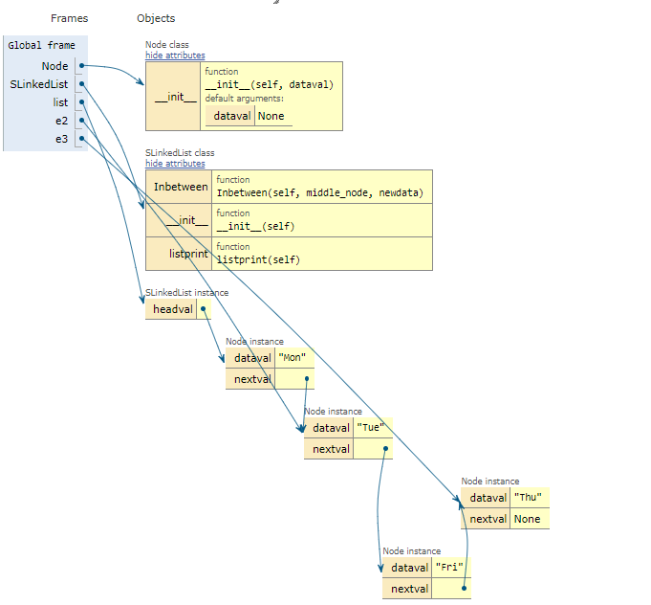
Inserting data between nodes

Slide 14

Stacks
Stack is a linear data structure which follows a particular order in which the operations are performed.
The order may be LIFO(Last In First Out) or FILO(First In Last Out).
Push: Adds an item in the stack. If the stack is full, then it is said to be an Overflow condition.
Pop: Removes an item from the stack. The items are popped in the reversed order in which they are pushed. If the stack is empty, then it is said to be an Underflow condition.
Peek or Top: Returns top element of stack.
isEmpty: Returns true if stack is empty, else false

Slide 15


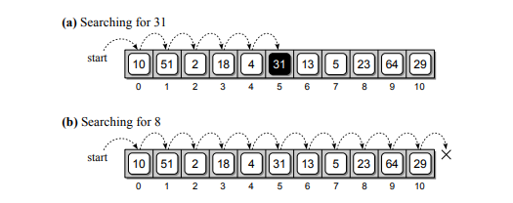
Searching
Searching is the process of selecting particular information from a collection of data based on specific criteria.
The Linear Search:
The simplest solution to the sequence search problem is the sequential or linear search algorithm.

Slide 16
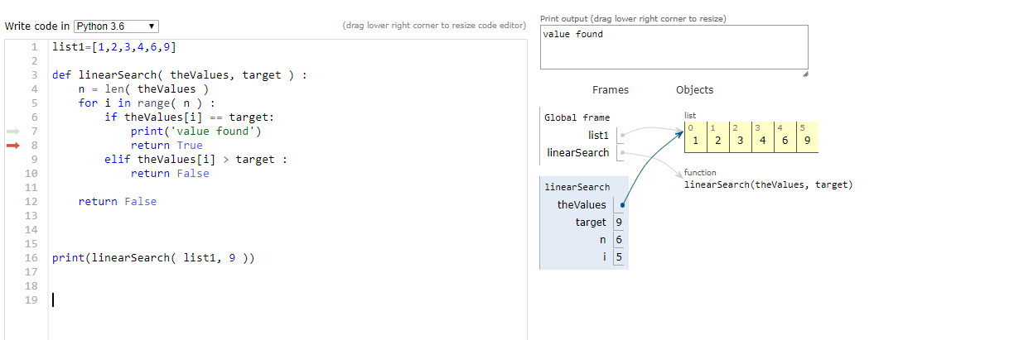

Slide 17
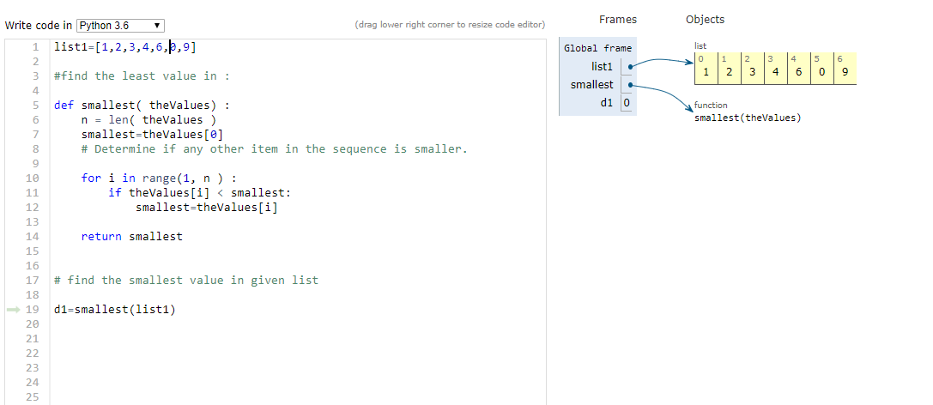
Finding the smallest value

Slide 18

The Binary Search
The binary search algorithm works in a similar fashion to the process described above and can be applied to a sorted sequence.
The algorithm starts by examining the middle item of the sorted sequence, resulting in one of three possible conditions:
the middle item is the target value, the target value is less than the middle item, or the target is larger than the middle item

Slide 19
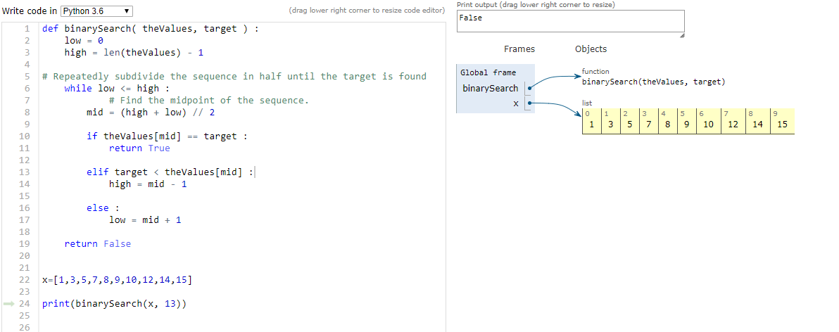

Slide 20
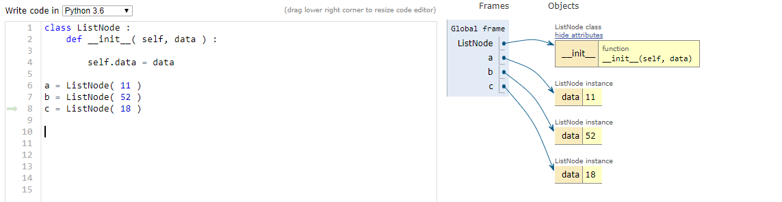
Linked Structures

Slide 21
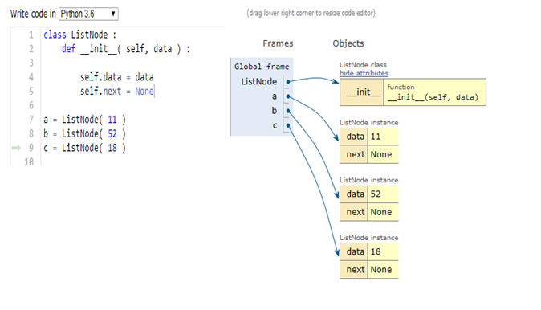
Linked list
Now, suppose we add a second data field to the ListNode class:

Slide 22
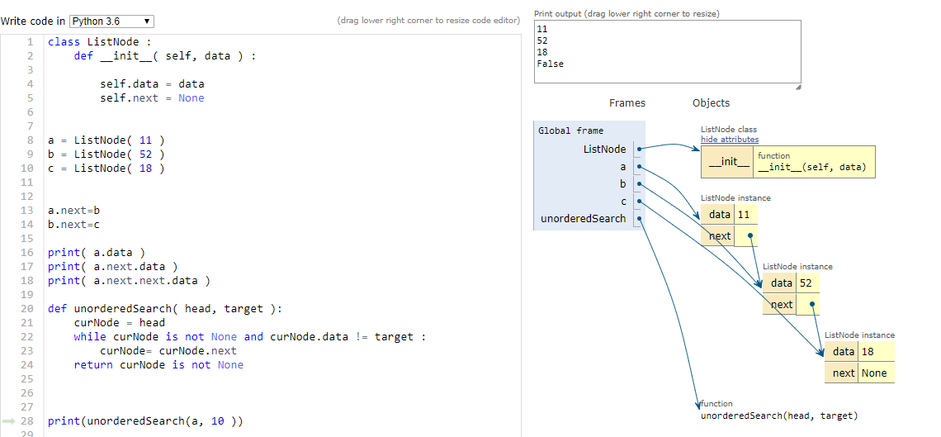

Slide 23
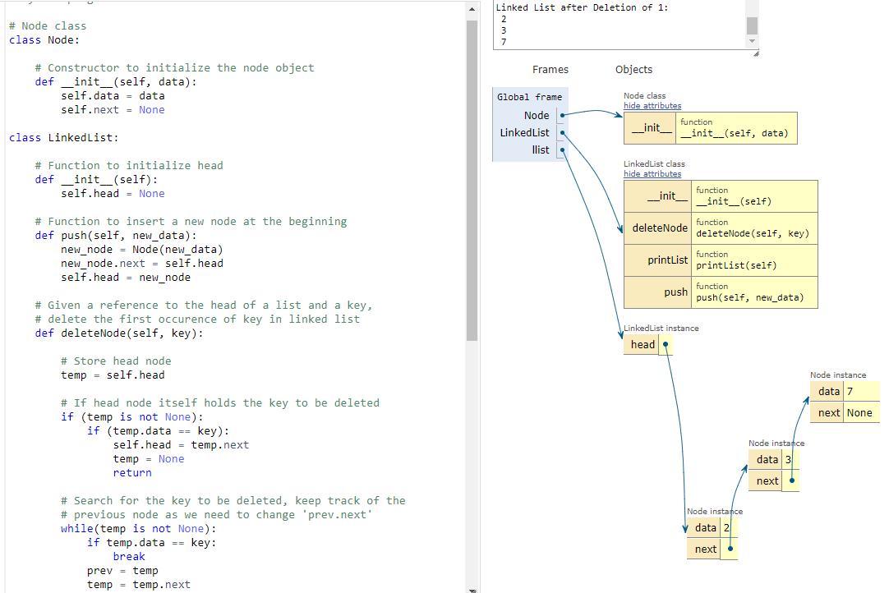
How to remove the node from linked list

Slide 24
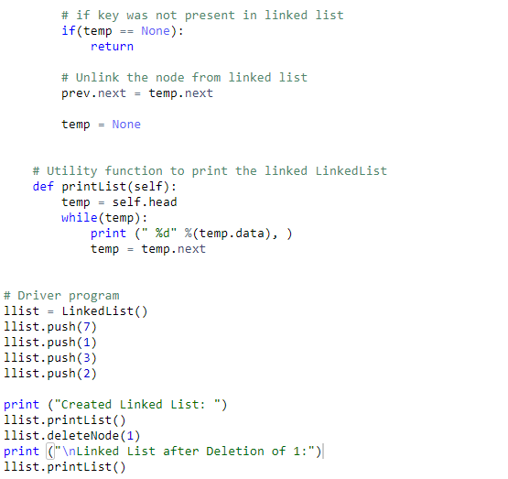

Slide 25
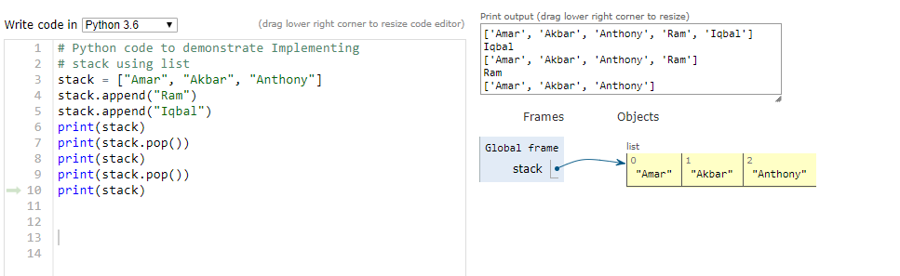
Stacks

Slide 26
Queues
A queue is a specialized list with a limited number of operations in which items can only be added to one end and removed from the other. A queue is also known as a first-in, first-out (FIFO).
Queue(): Creates a new empty queue, which is a queue containing no items.
isEmpty(): Returns a boolean value indicating whether the queue is empty.
length (): Returns the number of items currently in the queue.
enqueue( item ): Adds the given item to the back of the queue.
dequeue(): Removes and returns the front item from the queue. An item cannot be dequeued from an empty queue.

Slide 27

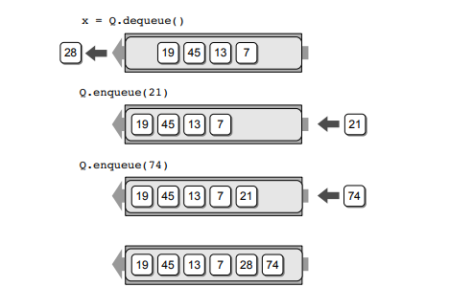

Slide 28
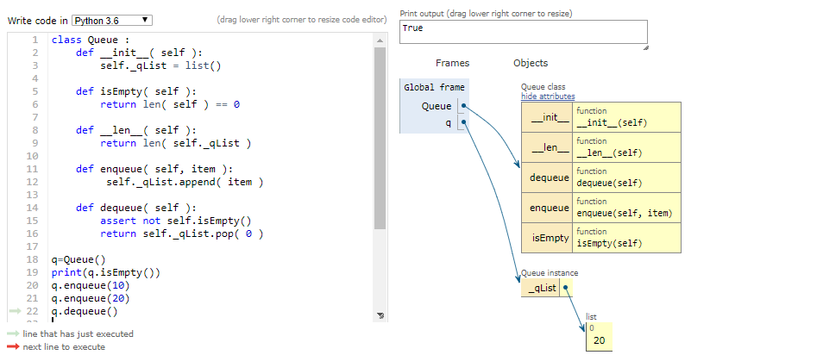

Slide 29
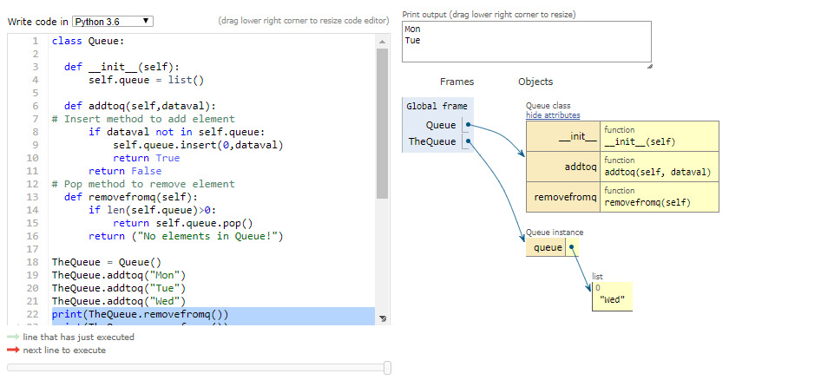
Queues example

Slide 30
Trees
A tree structure consists of nodes and edges that organize data in a hierarchical fashion.
The relationships between data elements in a tree are similar to those of a family tree: “child,” “parent,” “ancestor,” etc.
The data elements are stored in nodes and pairs of nodes are connected by edges.
The edges represent the relationship between the nodes that are linked with arrows or directed edges to form a hierarchical structure resembling an upside-down tree complete with branches, leaves, and even a root.

Slide 31
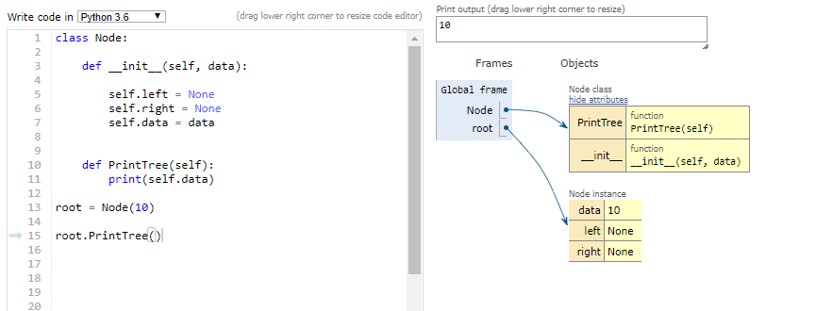
Sample example of tree

Slide 32
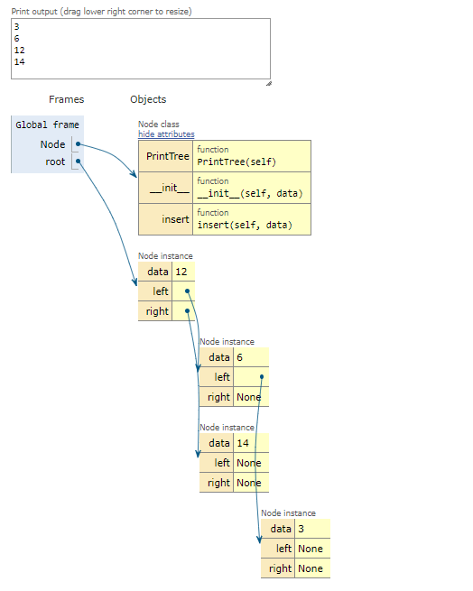
Example
Notes:
class Node: def __init__(self, data): self.left = None self.right = None self.data = data def insert(self, data):# Compare the new value with the parent node if self.data: if data < self.data: if self.left is None: self.left = Node(data) else: self.left.insert(data) elif data > self.data: self.right.insert(data) else: self.data = data# Print the tree def PrintTree(self): if self.left: self.left.PrintTree() print( self.data), if self.right: self.right.PrintTree()# Use the insert method to add nodesroot = Node(12)root.insert(6)root.insert(14)root.insert(3)root.PrintTree() if self.right is None: self.right = Node(data) else:

Slide 33
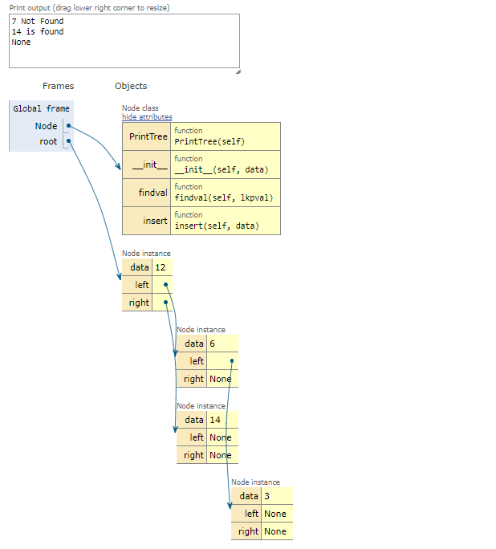

Example
Notes:
class Node: def __init__(self, data): self.left = None self.right = None self.data = data# Insert method to create nodes def insert(self, data): if self.data: if data < self.data: if self.left is None: self.left = Node(data) else: self.left.insert(data) elif data > self.data: if self.right is None: self.right = Node(data) else: self.right.insert(data) else: self.data = data# findval method to compare the value with nodes def findval(self, lkpval): if lkpval < self.data: if self.left is None: return str(lkpval)+" Not Found" return self.left.findval(lkpval) elif lkpval > self.data: if self.right is None: return str(lkpval)+" Not Found" return self.right.findval(lkpval) else: print(str(self.data) + ' is found')# Print the tree def PrintTree(self): if self.left: self.left.PrintTree() print( self.data), if self.right: self.right.PrintTree()root = Node(12)root.insert(6)root.insert(14)root.insert(3)print(root.findval(7))print(root.findval(14))

Slide 34

Python - Divide and conquer
Binary search
In divide and conquer approach, the problem in hand, is divided into smaller sub-problems and then each problem is solved independently.
When we keep on dividing the subproblems into even smaller sub-problems, we may eventually reach a stage where no more division is possible.
Those "atomic" smallest possible sub-problem (fractions) are solved. The solution of all sub-problems is finally merged in order to obtain the solution of an original problem.

Slide 35
To be continued

